Slide 1
Disk Scheduling Algorithms in OS (Operating System)

Slide 2
Disk Scheduling Algorithms in OS (Operating System)
As we know, a process needs two type of time, CPU time and IO time. For I/O, it requests the Operating system to access the disk.
However, the operating system must be fare enough to satisfy each request and at the same time, operating system must maintain the efficiency and speed of process execution.
The technique that operating system uses to determine the request which is to be satisfied next is called disk scheduling.
Let's discuss some important terms related to disk scheduling.

Slide 3
Important Terms
Seek Time
Seek time is the time taken in locating the disk arm to a specified track where the read/write request will be satisfied.
Rotational Latency
It is the time taken by the desired sector to rotate itself to the position from where it can access the R/W heads.
Transfer Time
It is the time taken to transfer the data.

Slide 4
Important Terms
Disk Access Time
Disk access time is given as,
Disk Access Time = Rotational Latency + Seek Time + Transfer Time
Disk Response Time
It is the average of time spent by each request waiting for the IO operation.

Slide 5
Purpose and Goal of Disk Scheduling
The main purpose of disk scheduling algorithm is to select a disk request from the queue of IO requests and decide the schedule when this request will be processed.
Goals
Fairness
High throughout
Minimal traveling head time

Slide 6
Disk Scheduling Algorithms
The list of various disks scheduling algorithm is given below. Each algorithm is carrying some advantages and disadvantages. The limitation of each algorithm leads to the evolution of a new algorithm.
FCFS scheduling algorithm
SSTF (shortest seek time first) algorithm
SCAN scheduling
C-SCAN scheduling
LOOK Scheduling
C-LOOK scheduling

Slide 7
FCFS Scheduling Algorithm
It is the simplest Disk Scheduling algorithm. It services the IO requests in the order in which they arrive. There is no starvation in this algorithm, every request is serviced.
Drawbacks:
The scheme does not optimize the seek time.
The request may come from different processes therefore there is the possibility of inappropriate movement of the head.

Slide 8
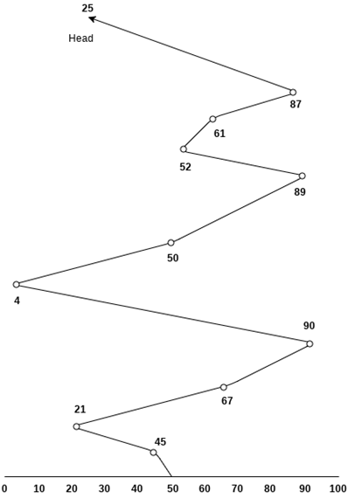
Example
Consider the following disk request sequence for a disk with 100 tracks
45, 21, 67, 90, 4, 50, 89, 52, 61, 87, 25. Head pointer starting at 50 and moving in left direction. Find the number of head movements in cylinders using FCFS scheduling.

Slide 9
Example
Number of cylinders moved by the head
= (50-45)+(45-21)+(67-21)+(90-67)+(90-4)+(50-4)+(89-50)+(61-52)+(87-61)+(87-25)
= 5 + 24 + 46 + 23 + 86 + 46 + 49 + 9 + 26 + 62
= 376

Slide 10
SSTF Scheduling Algorithm
Shortest seek time first (SSTF) algorithm selects the disk I/O request which requires the least disk arm movement from its current position regardless of the direction. It reduces the total seek time as compared to FCFS.
It allows the head to move to the closest track in the service queue.

Slide 11
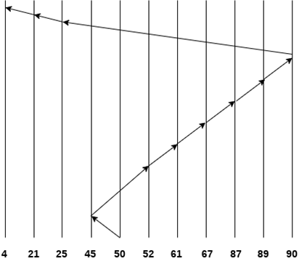
SSTF Scheduling Algorithm
Example OS SSTF Scheduling Algorithm - javatpoint
Consider the following disk request sequence for a disk with 100 tracks
45, 21, 67, 90, 4, 89, 52, 61, 87, 25
Head pointer starting at 50. Find the number of head movements in cylinders using SSTF scheduling.
Number of cylinders = 5 + 7 + 9 + 6 + 20 + 2 + 1 + 65 + 4 + 17 = 136

Slide 12
SSTF Scheduling Algorithm
Disadvantages
It may cause starvation for some requests.
Switching direction on the frequent basis slows the working of algorithm.
It is not the most optimal algorithm.

Slide 13
SCAN and C-SCAN algorithm
Scan Algorithm
It is also called as Elevator Algorithm. In this algorithm, the disk arm moves into a particular direction till the end, satisfying all the requests coming in its path,and then it turns backand moves in the reverse direction satisfying requests coming in its path.
It works in the way an elevator works, elevator moves in a direction completely till the last floor of that direction and then turns back.
Example
Consider the following disk request sequence for a disk with 100 tracks
98, 137, 122, 183, 14, 133, 65, 78
Head pointer starting at 54 and moving in left direction. Find the number of head movements in cylinders using SCAN scheduling.

Slide 14
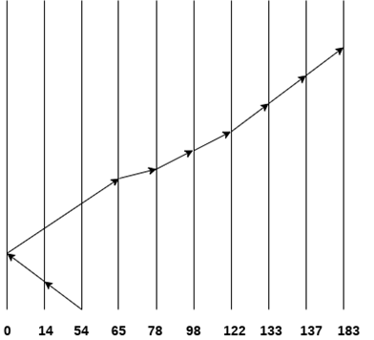
SCAN and C-SCAN algorithm
98, 137, 122, 183, 14, 133, 65, 78
Number of Cylinders = 40 + 14 + 65 + 13 + 20 + 24 + 11 + 4 + 46 = 237

Slide 15
C-SCAN algorithm
In C-SCAN algorithm, the arm of the disk moves in a particular direction servicing requests until it reaches the last cylinder, then it jumps to the last cylinder of the opposite direction without servicing any request then it turns back and start moving in that direction servicing the remaining requests.
Example
Consider the following disk request sequence for a disk with 100 tracks
98, 137, 122, 183, 14, 133, 65, 78
Head pointer starting at 54 and moving in left direction. Find the number of head movements in cylinders using C-SCAN scheduling.

Slide 16
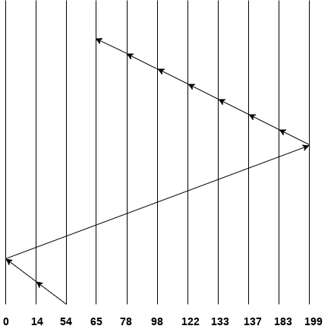
C-SCAN algorithm
98, 137, 122, 183, 14, 133, 65, 78
No. of cylinders crossed = 40 + 14 + 199 + 16 + 46 + 4 + 11 + 24 + 20 + 13 = 387

Slide 17
Look Scheduling
It is like SCAN scheduling Algorithm to some extant except the difference that, in this scheduling algorithm, the arm of the disk stops moving inwards (or outwards) when no more request in that direction exists. This algorithm tries to overcome the overhead of SCAN algorithm which forces disk arm to move in one direction till the end regardless of knowing if any request exists in the direction or not.
Example
Consider the following disk request sequence for a disk with 100 tracks
98, 137, 122, 183, 14, 133, 65, 78
Head pointer starting at 54 and moving in left direction. Find the number of head movements in cylinders using LOOK scheduling.

Slide 18
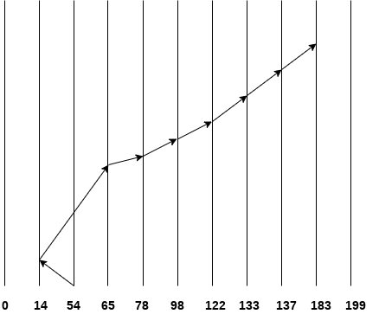
Look Scheduling
Number of cylinders crossed = 40 + 51 + 13 + +20 + 24 + 11 + 4 + 46 = 209

Slide 19
C Look Scheduling
C Look Algorithm is similar to C-SCAN algorithm to some extent. In this algorithm, the arm of the disk moves outwards servicing requests until it reaches the highest request cylinder, then it jumps to the lowest request cylinder without servicing any request then it again start moving outwards servicing the remaining requests.
It is different from C SCAN algorithm in the sense that, C SCAN force the disk arm to move till the last cylinder regardless of knowing whether any request is to be serviced on that cylinder or not.
Example
Consider the following disk request sequence for a disk with 100 tracks
98, 137, 122, 183, 14, 133, 65, 78
Head pointer starting at 54 and moving in left direction. Find the number of head movements in cylinders using C LOOK scheduling.

Slide 20
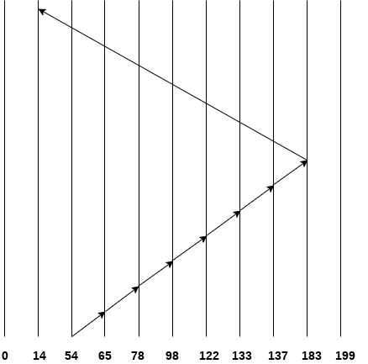
C Look Scheduling
Number of cylinders crossed = 11 + 13 + 20 + 24 + 11 + 4 + 46 + 169 = 298

Slide 21
Numerical on SSTF and SCAN
Question:
Suppose the following disk request sequence (track numbers) for a disk with 100 tracks is given: 45, 20, 90, 10, 50, 60, 80 and 70. Assume that the initial position of the R/W head is on track 50. The additional distance that will be traversed by the R/W head when the Shortest Seek Time First (SSTF) algorithm is used compared to the SCAN (Elevator) algorithm (assuming that SCAN algorithm moves towards 100 when it starts execution) is _________ tracks
(A) 5 (B) 9 (C) 10 (D) 11

Slide 22
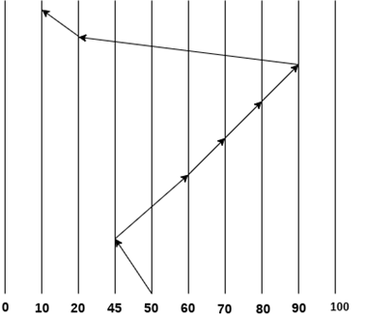
Using SSTF Algorithm
Number of track are 100
Initial Position of R/W head is 50.
The requests are: 45, 20, 90, 10, 50, 60, 80 and 70
Number of crossed cylinders = 5 + 15 + 10 + 10 + 10 + 70 + 10 = 130

Slide 23
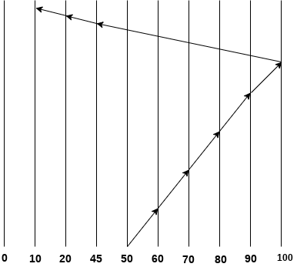
Using SCAN Algorithm
Number of cylinders crosses = 0 + 10 + 10 + 10 + 10 + 10 + 55 + 25 + 10 = 140
Therefore the answer is (C). The SCAN algorithm travels for 10 additional tracks.

Slide 24
Numerical on Disk Scheduling Algorithms
Q. Consider a disk with 200 tracks and the queue has random requests from different processes in the order:
55, 58, 39, 18, 90, 160, 150, 38, 184
Initially arm is at 100. Find the Average Seek length using FIFO, SSTF, SCAN and C-SCAN algorithm.
Solution :

Slide 25
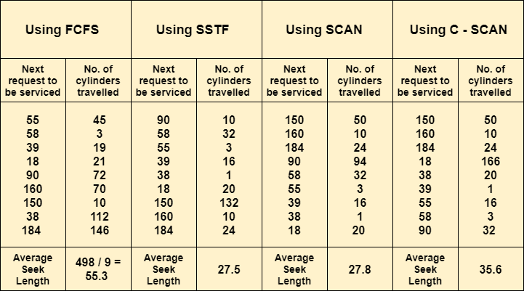
Numerical on Disk Scheduling Algorithms

